Slide 1
RAPID PROTOTYPING PRACTICE USING OBJECT ORIENTED PROGRAMMING
AUTOMATIC TIMETABLE GENERATION SYSTEM
Project By: 612203025 Nidhi Chaudhari
612203031 Shraddha Darade
612203032 Rutuja Dautpure

Slide 2
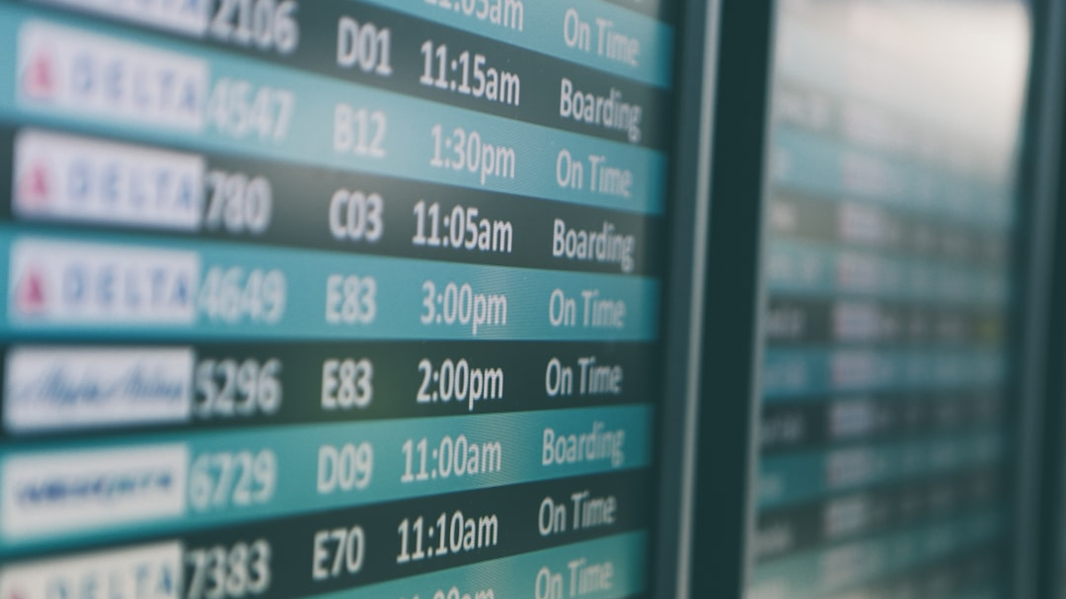
INTRODUCTION
Overview of the automatic timetable generation project
The Automatic Timetable Generation System is designed to automate the process of creating timetables for educational institutions⁠
Problem statement: Educational institutions need an automated solution to generate optimized timetables that meet various constraints and preferences.

Slide 3

CHALLENGES
Identifying the key challenges faced in manual timetable generation
-Time consuming process
-Difficulty in accommodating various constraints and preferences

Slide 4

OBJECTIVES OF THE PROJECT
To develop an Automatic Timetable Generation System that automates timetable creation, considers constraints, and provides efficient scheduling solution.

Slide 5
KEYWORDS/MODULES
• Timetable Generation
• User Authentication and Registration
•⁠ Admin Dashboard
•⁠ Teacher Management
•⁠ ⁠Classroom Management
•⁠ ⁠Email Notification
•⁠ ⁠PDF Download System

Slide 6
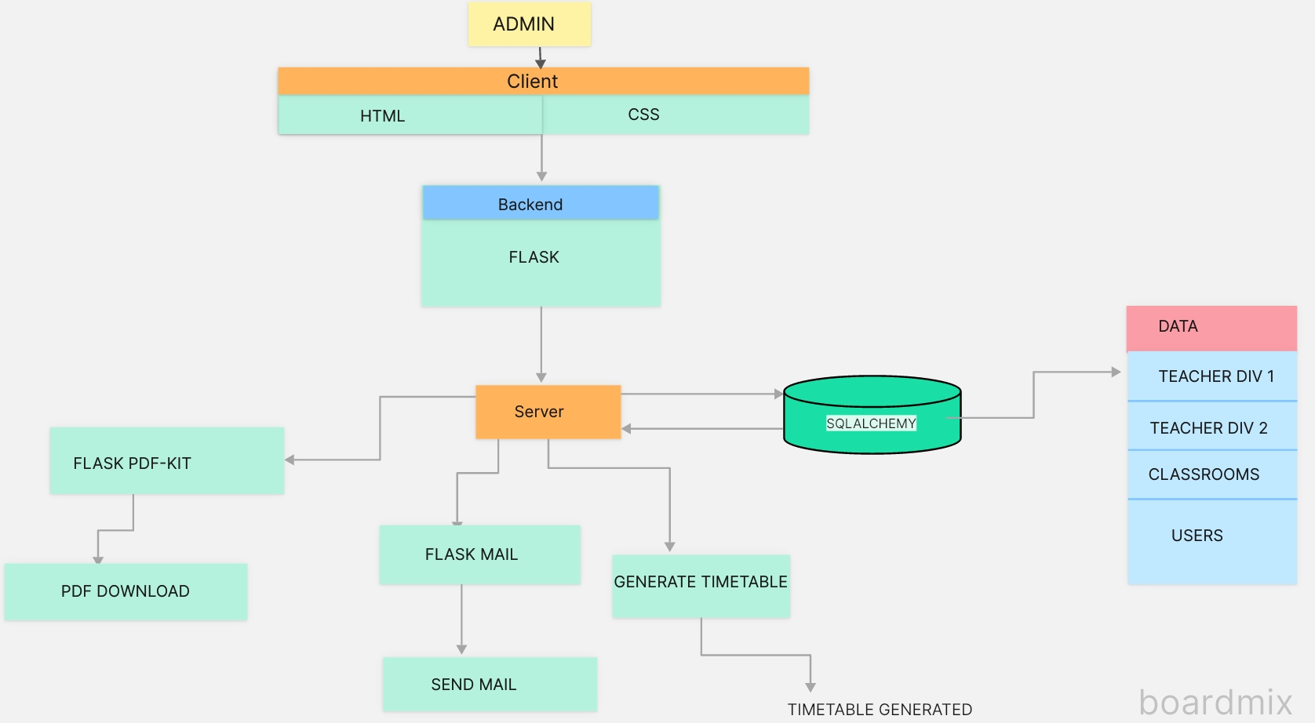

Slide 7
MODULE WISE DESCRIPTION

Slide 8
USER AUTHENTICATION AND REGISTRATION
Explanation: Handles user authentication and registration functionalities.
Technologies used: Flask,SqlAlchemy

Slide 9
ADMIN DASHBOARD
Overview: Centralized interface for adminstrators to manage system settings and view generated timetables.
Features: Add, edit and delete teachers, add Classrooms, view User Account.
Technologies used: Flask,SqlAlchemy,HTML,CSS.

Slide 10
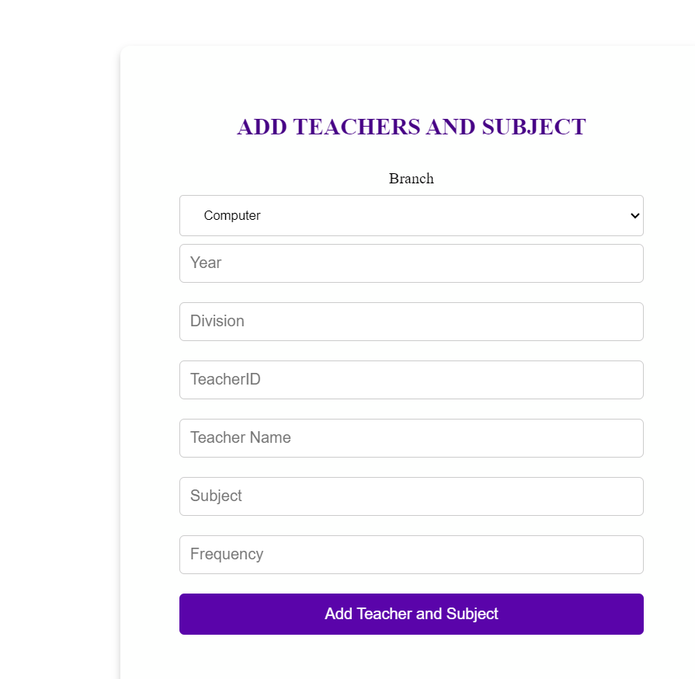
TEACHER MANAGEMENT
Details: Manage Teacher profile, including adding new teachers,updating the information, and assigning the subject to the teachers.
Technologies used: Flask,SqlAlchemy.

Slide 11
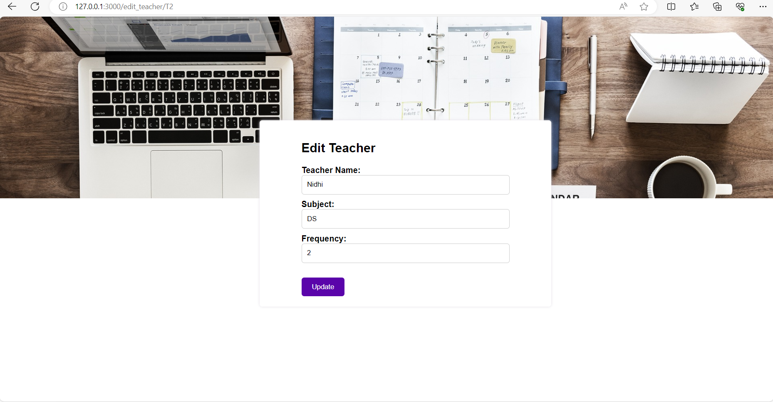

Slide 12
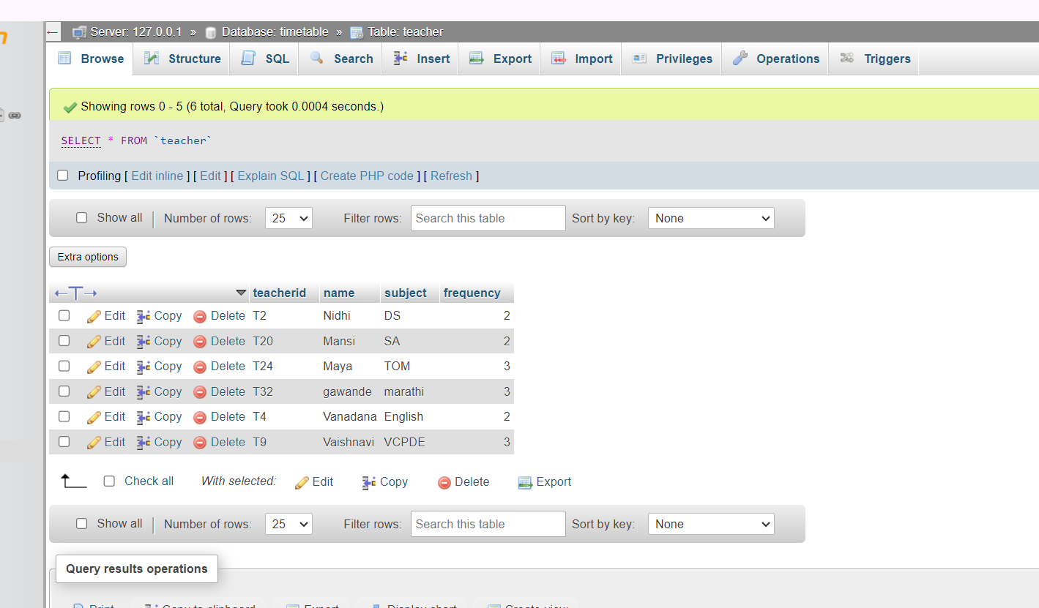

Slide 13
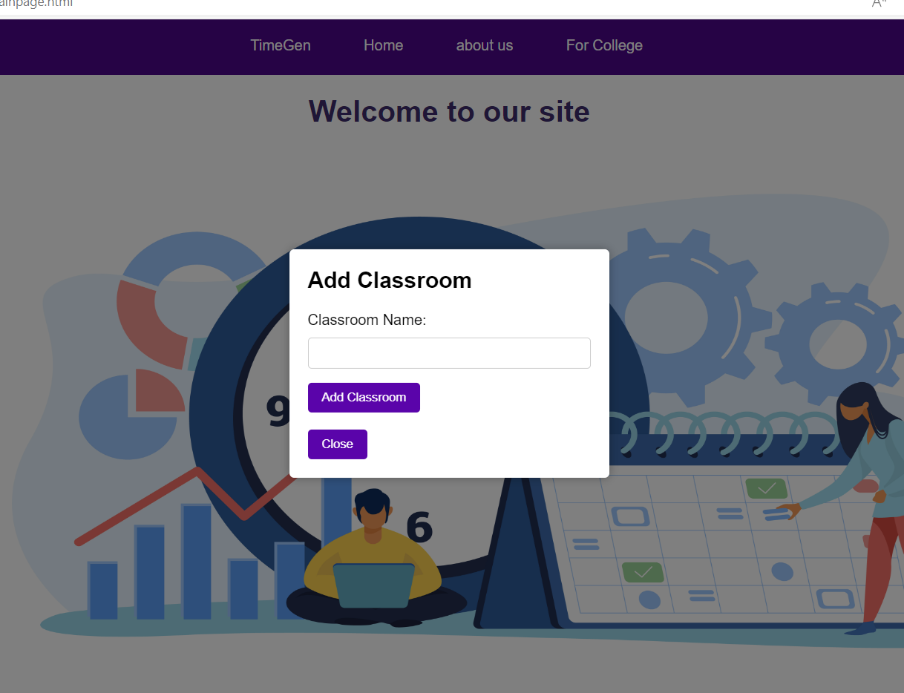
CLASSROOM MANAGEMENT
Details: Manage Classroom resources and Allocations.
Technologies used: Flask,SqlAlchemy.

Slide 14
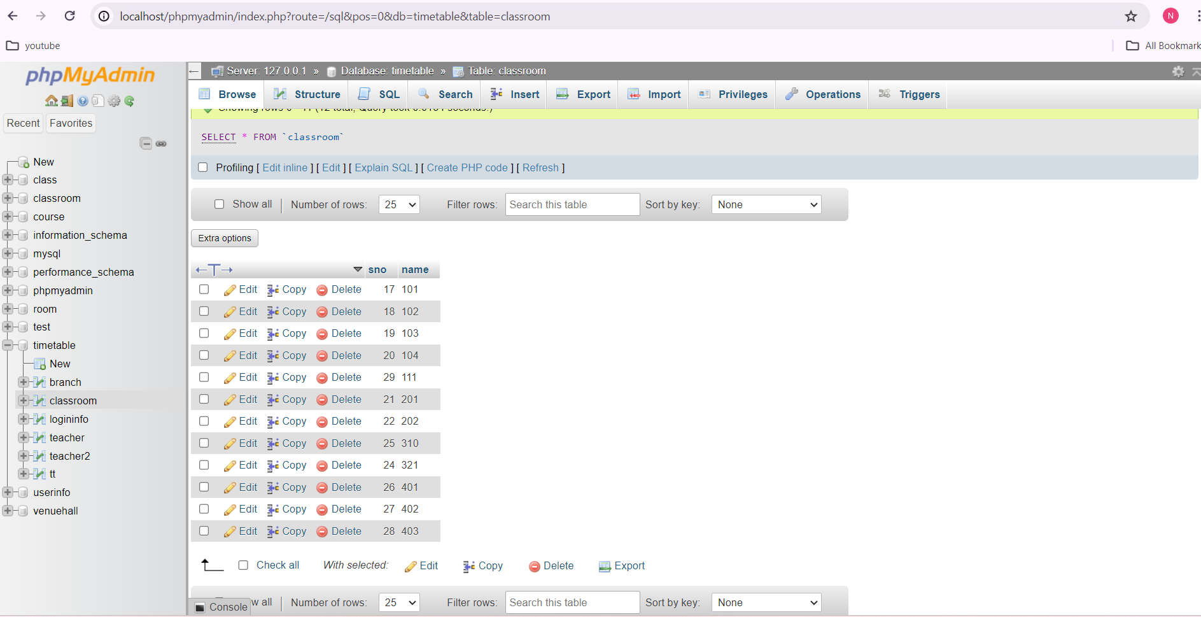

Slide 15
EMAIL NOTIFICATION
Integration: Implementing an email OTP functionality for secure password reset in case of forget password and also when the user creates the account successfully.
Technologies used: Flask,Flask-Mail.

Slide 16
TIMETABLE GENERATION ALGORITHM
Description: Core module implementing algorithms for timetable generation.
⁠Considerations: Factors such as class schedules, teacher availability, subject requirements, and classroom capacities.
Technologies used: Flask, Python

Slide 17
Timetable Generation:
Algorithm:
- Initialization: Define time slots and retrieve teachers, subjects, and classrooms.
- Loop: For each day:
- Randomization: Shuffle teachers.
- Assignment:Assign teachers and classrooms.
- Constraints: Ensure classrooms are not overlapped.
- Approach:
- Greedy: Assigns subjects without considering future constraints.
- Randomization: Introduces randomness to reduce bias.
- Efficient:Optimally schedules subjects within available slots.
- Result:
- Timetables generated effectively, optimizing resource utilization.

Slide 18
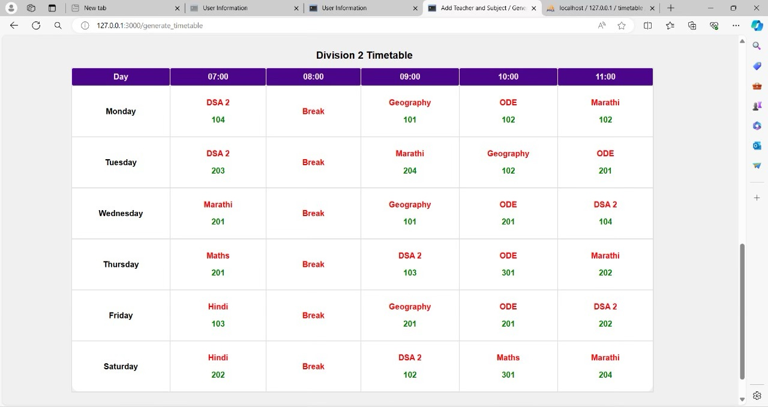

Slide 19
PDF SYSTEM
Objectives : Enable users to download generated PDF timetables.
-The pdf is being generated by fetching timetable data, organising it by division and day, then generate a PDF from HTML template. Finally, it serves the PDF in response to a POST request.
Technologies used: Flask, Python,PDFkit

Slide 20
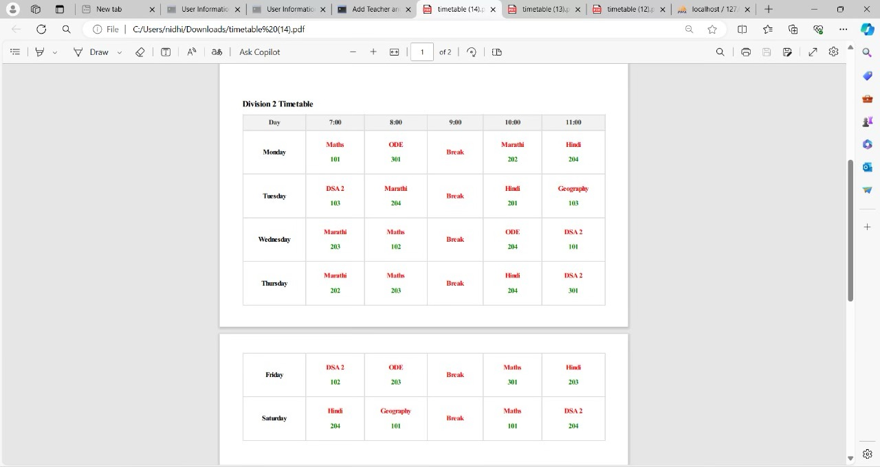

Slide 21
TECHNOLOGY SELECTED
-FLASK
-SQLALCHEMY
-FLASK-MAIL
-HTML/CSS
-FLASK PDF KIT

Slide 22
CONCLUSIONS
Summary: The Automatic Timetable Generation System offers a comprehensive solution to the challenges of manual timetable creation in educational institutions.
Benefits: Streamlining scheduling processes, minimizing conflicts, and optimizing resource utilization.
Impact: Enhancing efficiency and effectiveness in educational institutions, leading to improved academic outcomes and stakeholder satisfaction.

Slide 23
THANK YOU

